Slide 1
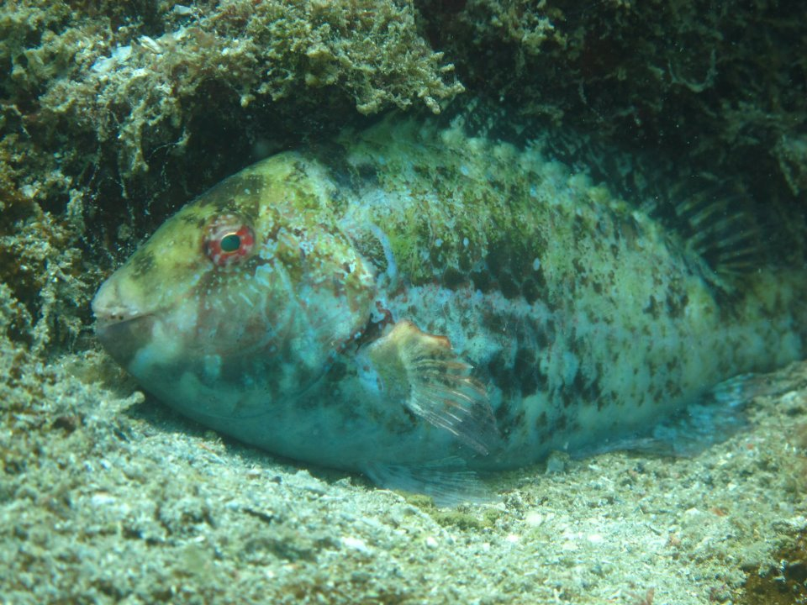


Macroalgal removal and feeding selectivity of fishes on subtropical reefs
Thiago C. Mendes & Carlos Eduardo L. Ferreira
Notes:
Good afternoon to all; thanks for your presence here today.
My name is Thiago. I'm a PhD candidate in Brazil and I'm developing a thesis focusing on reef fish herbivory in our subtropical rocky reefs there. Today I'll be presenting a part of my thesis and it deals with Macroalgal removal and feeding selectivity of fishes on subtropical reefs.

Slide 2
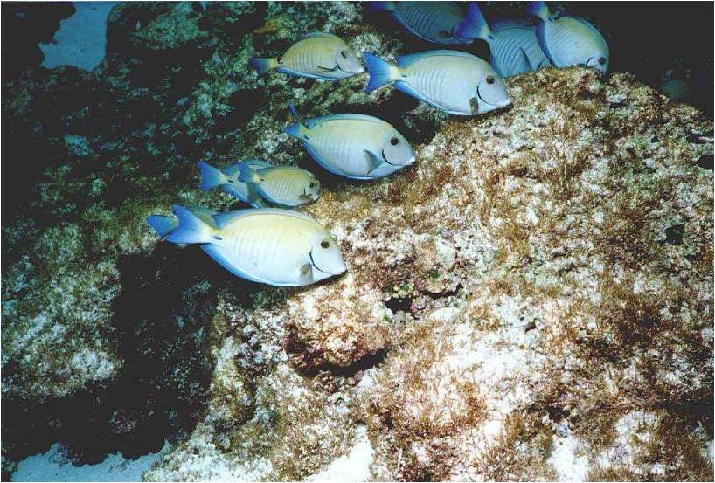
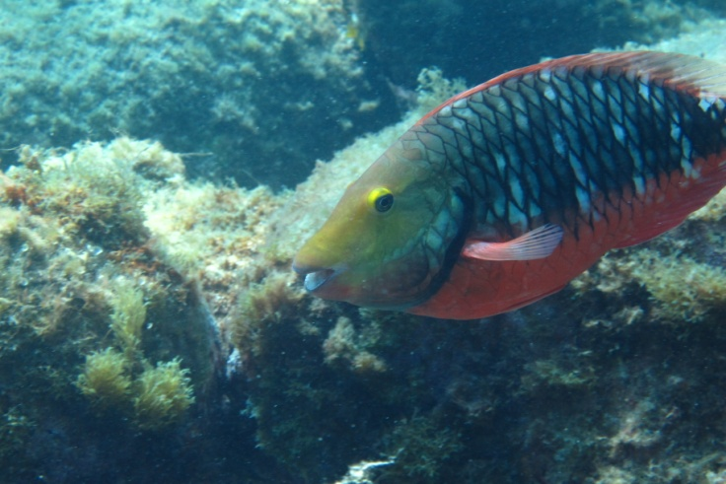
Importance of herbivorous fishes
Herbivory on tropical reefs influences the abundance, ditribution, composition, diversity and productivity of macro and turfing algae
Carpenter (1986); Mumby et al. (2006)
Mantain key processes in tropical reefs
Bellwood et al. (2004)

Slide 3
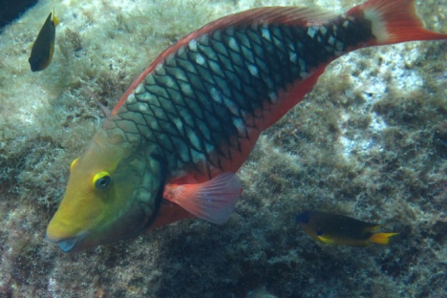
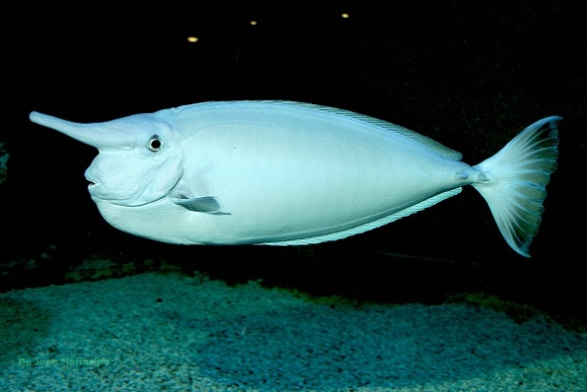
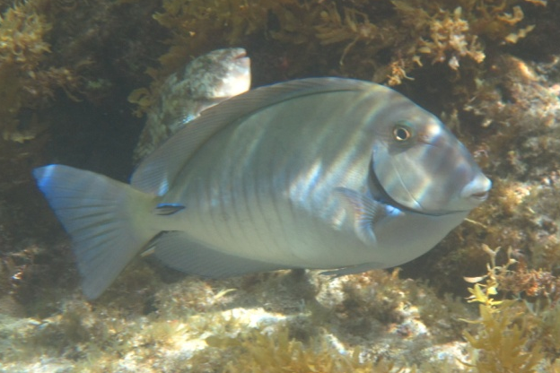
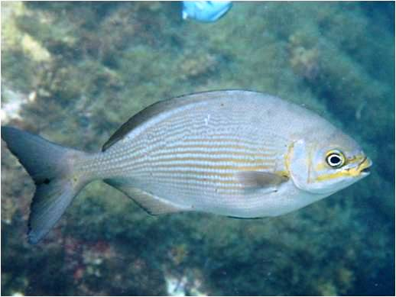
Importance of herbivorous fishes
X
Variety of feeding and food procesing modes
Choat et al. (2002; 2004); Crossman et al. (2005)
Notes:
Besides, depicting the selectivity of herbivorous fishes towards their feeding resource is very important since they exhibit a vast array of feeding and food processing modes which may shape this selectivity. For instance, species with simpler guts tend to forage on protein-rich turfing form algae, while species capable of breaking more complex polycchararides, tend to browse macroalgae. (Choat et al. 2002; 2004). They tend to favor green and red algae over browns.

Slide 4
Objectives
Determine the pressure of fish on different macroalgal species on subtropical reefs;
Depict the selectivity patterns of nominally herbivorous fishes toward these algae.
Notes:
Based on that, our objectives here were two: First, determine how great is the pressure of fish on different macroalgal species and second to depict the selectivity patterns of nominally herbivorous fishes toward these algae. Basically, we'd like to know which algae are preferred and which are avoided by the most important herbivores.

Slide 5
Multiple choice feeding experiments
Notes:
For this purpose we used a multiple choice feeding experiment...

Slide 6
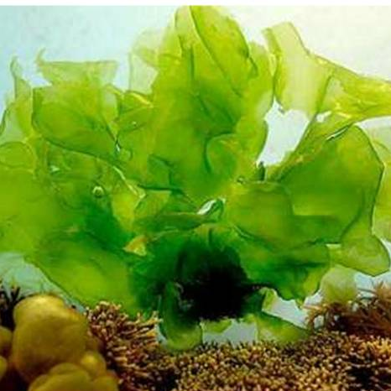
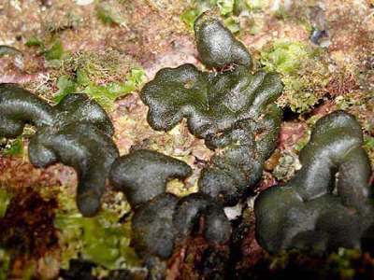
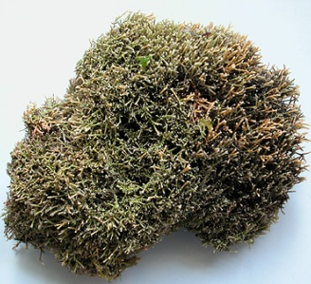
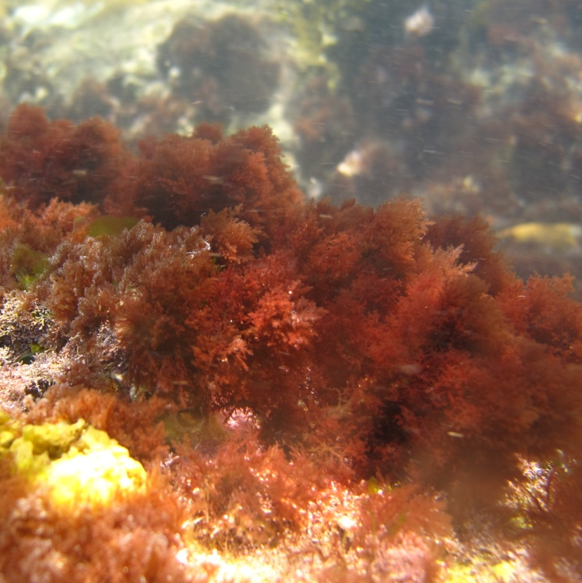
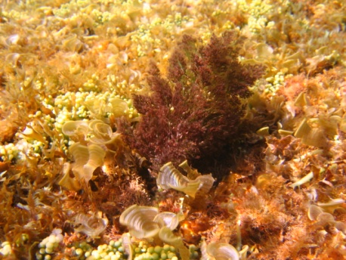
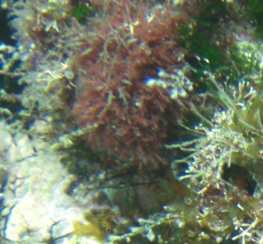
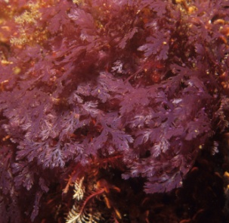
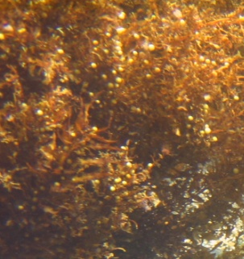
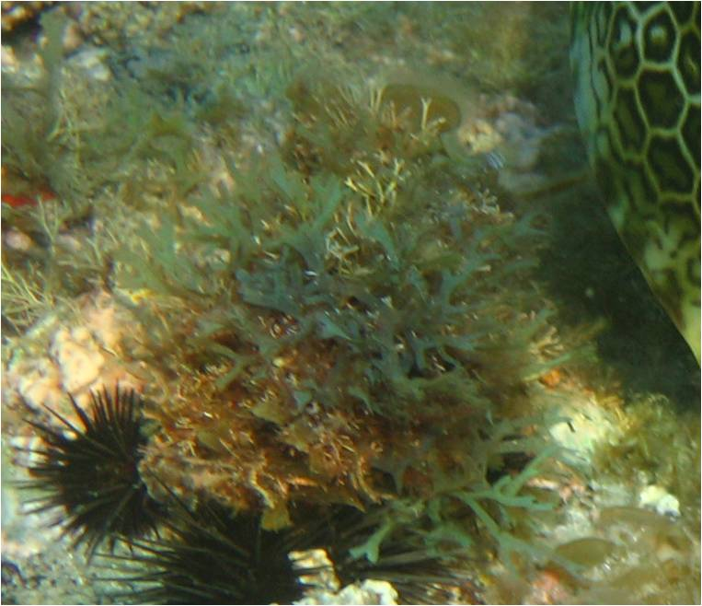
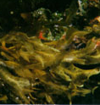
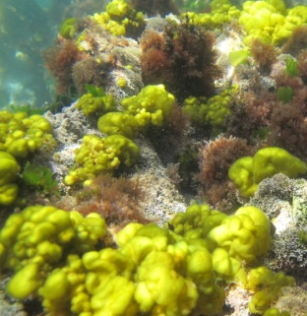
Multiple choice feeding experiments
Ulva fasciata
Codium intertextum
Amphiroa sp.
Spyridia hypnoides
Laurencia dendroidea
Laurencia filiformis
Plocamium brasiliensis
Sargassum furcatum
Dictyota sp.
Dictyopteris plagiogramma
Colpomenia sinuosa
Notes:
...in which we used these eleven macroalgal species.
These species were chosen since they are among the most abundant macroalgal species in our study area and represent different taxonomic and morphological groups.
Most of these algae are also known to be dietary to at least some nominally herbivore in our study area.

Slide 7
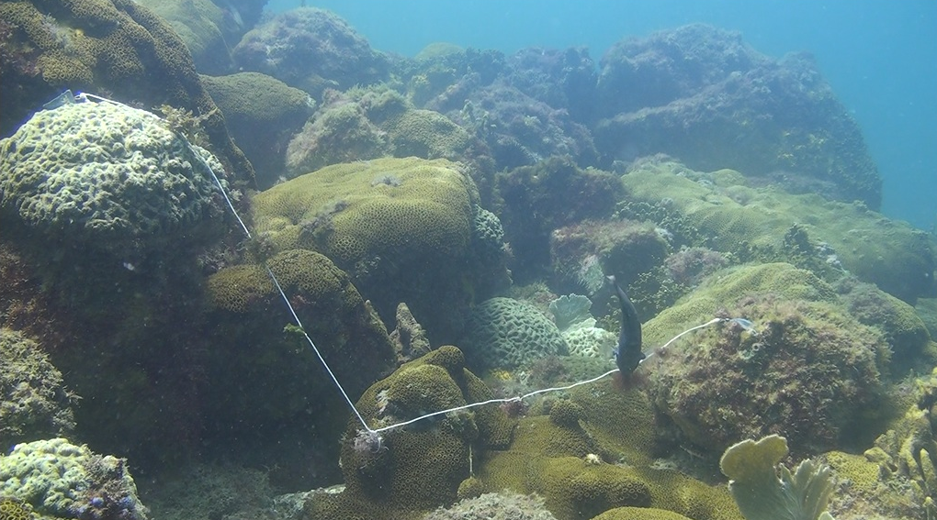
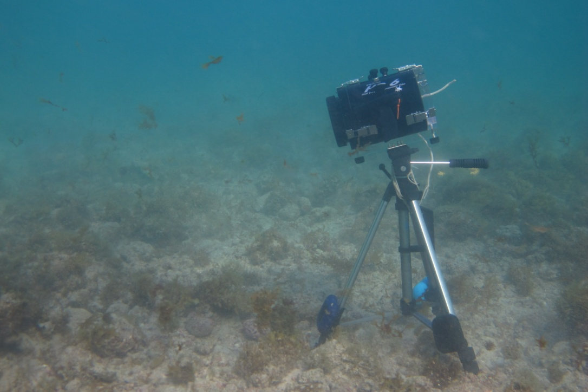
Multiple choice feeding experiments
Frame da filmagem
Notes:
The algae were tied to a thin rope and laid in the fiel for 1h period. All algae were weighted before and after the experiment.
All the assays were also filmed in order to assess which species were

Slide 8
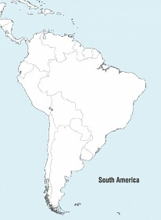
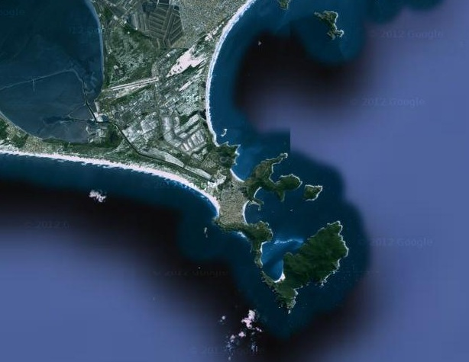

Study area
Notes:
The assays were deployed in two different areas distant ca. 1,5km from each other.

Slide 9
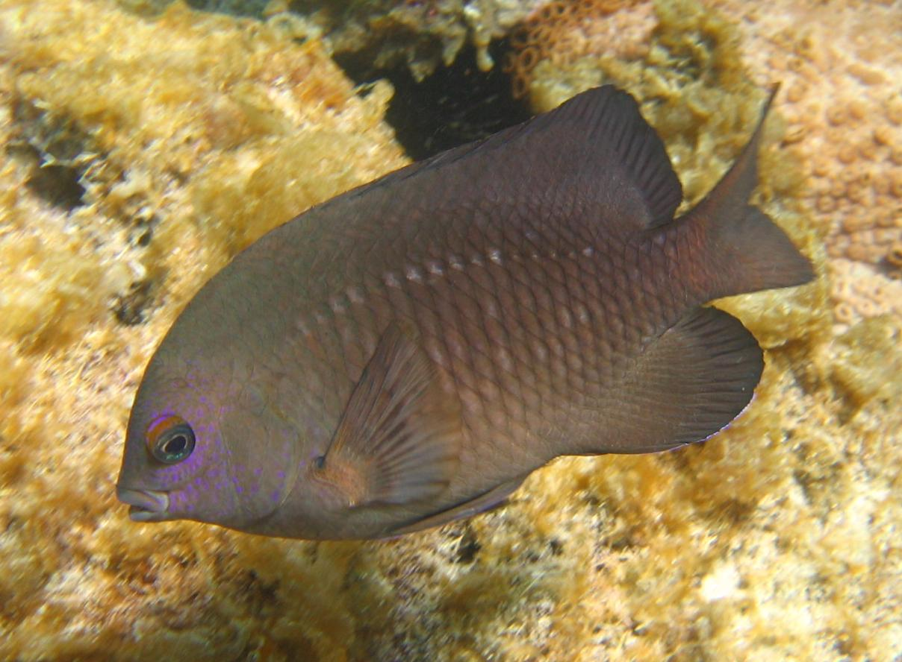
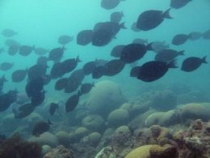

Fish community
30% biomass of herbivores

Slide 10
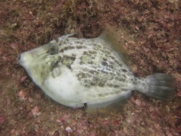
Fish community
30% biomass of herbivores
20% biomass of omnivores
Biomass (g.20m⁻¹ ±SE)

Slide 11

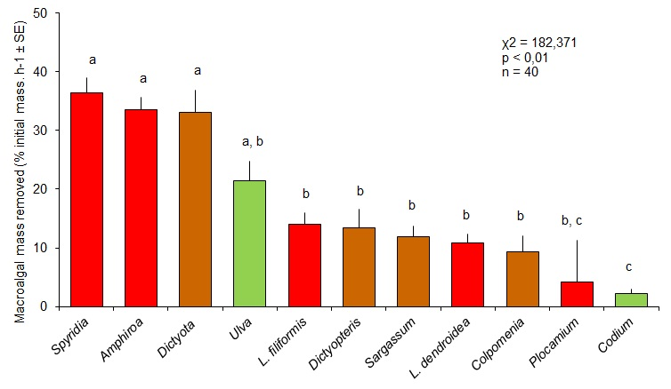
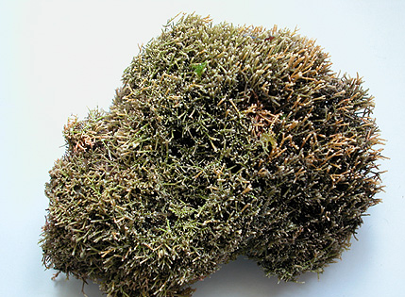
Algal mass lost after 1h

Slide 12

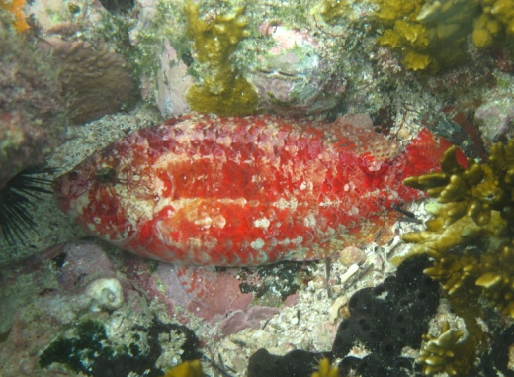

Bites

Slide 13
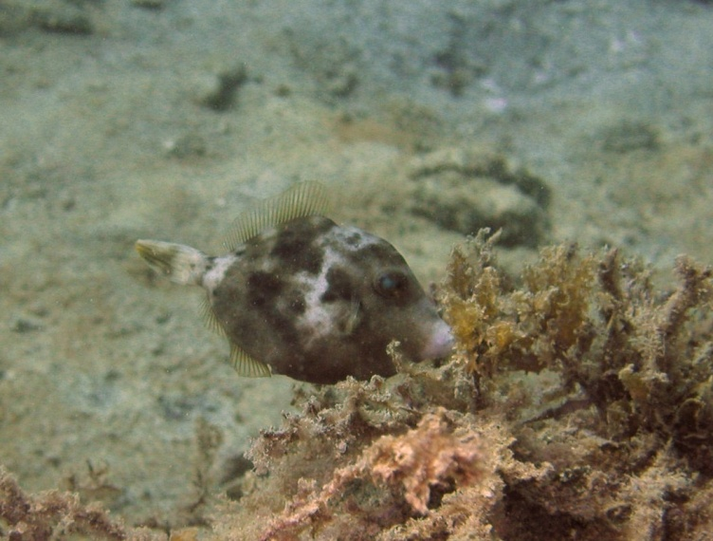
Selectivity pattern (L)
Stephanolepis hispidus
Selectivity index (mean L ± 95% CI)
Stegastes fuscus

Slide 14
Selectivity pattern (L)
Stephanolepis hispidus
Both fed non-selectively
Selectivity index (mean L ± 95% CI)
Stegastes fuscus

Slide 15
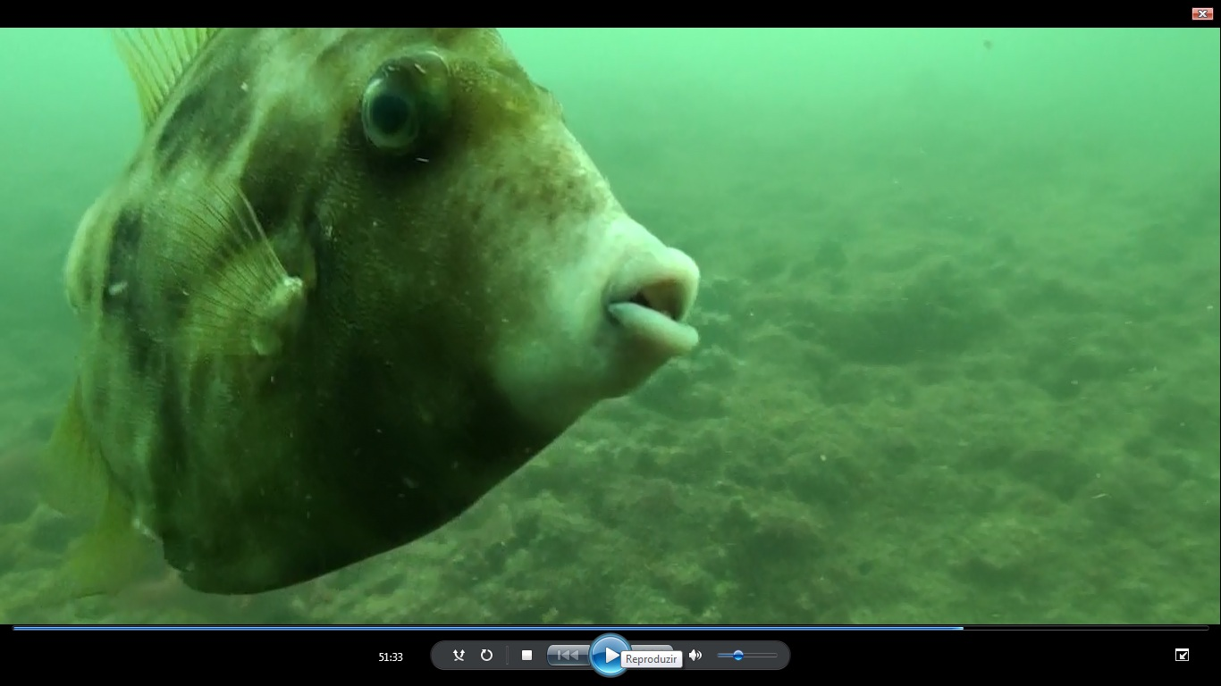
Selectivity pattern (L)
Stephanolepis hispidus
Selectivity index (mean L ± 95% CI)
Stegastes fuscus

Slide 16
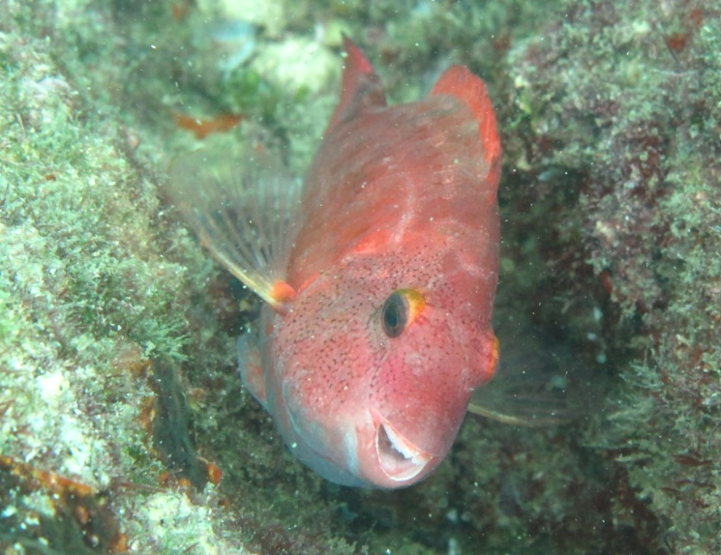
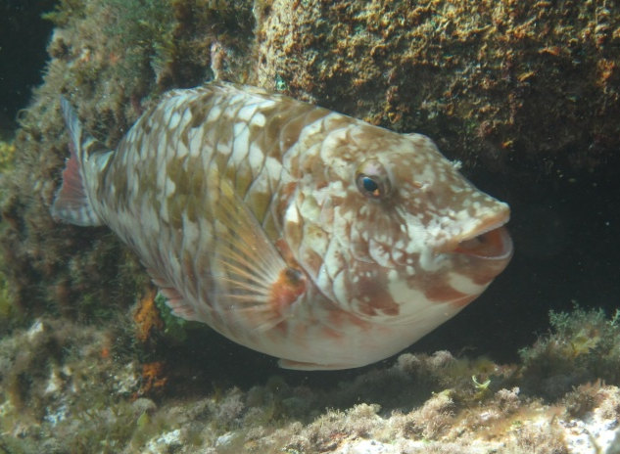
Selectivity patterns (L)
Sparisoma tuiupiranga
Selectivity index (mean L ± 95% CI)
Sparisoma axillare

Slide 17
Selectivity patterns (L)
Sparisoma tuiupiranga
Both selected Amphiroa and Spyridia
Selectivity index (mean L ± 95% CI)
Sparisoma axillare

Slide 18
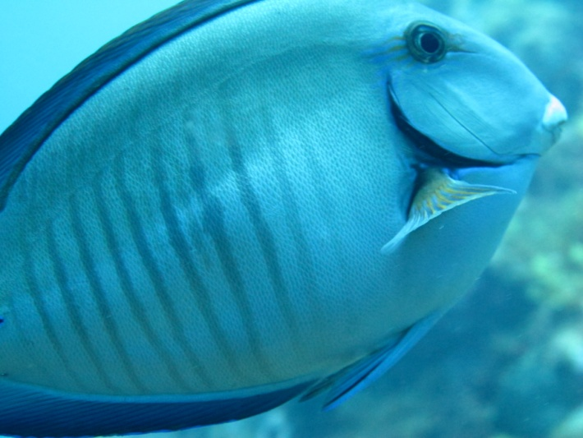
Selectivity patterns (L)
Acanthurus chirurgus
Selectivity index (mean L ± 95% CI)
Acanthurus bahianus

Slide 19
Selectivity patterns (L)
Acanthurus chirurgus
Both selected Amphiroa and Spyridia
Selectivity index (mean L ± 95% CI)
Acanthurus bahianus

Slide 20
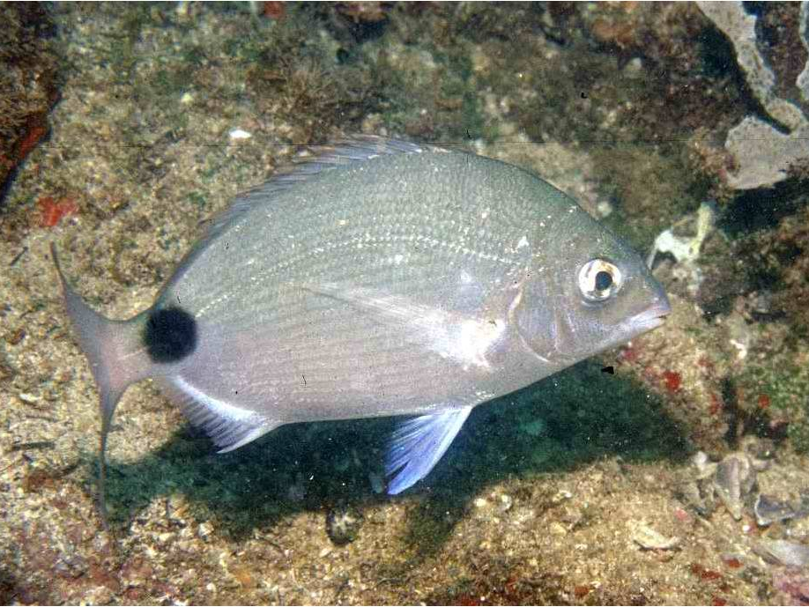
Selectivity patterns (L)
Diplodus argenteus
Selectivity index (mean L ± 95% CI)
Kyphosus sp.

Slide 21
Selectivity patterns (L)
Diplodus argenteus
Ulva
Selectivity index (mean L ± 95% CI)
Kyphosus sp.

Slide 22
Selectivity patterns (L)
Diplodus argenteus
Ulva
Selectivity index (mean L ± 95% CI)
Brown algae
Kyphosus sp.

Slide 23
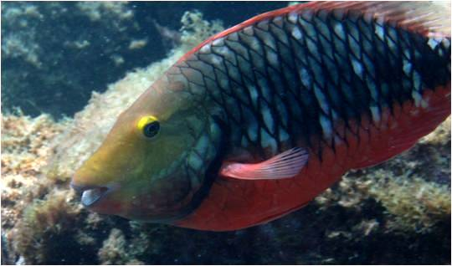
Conclusions
Sparisoma spp.
Acanthurus spp.
Similar selectivity patterns
Redundancy within and between these two families
Notes:
In general brown algae were largely avoided (especially Colpomenia) by most fishes. The exception was Kyphosus that selected primarily Dictyota and Dictyopteris, and to a lesser extent, Sargassum. In fact, this genera is known to posses endosymbiontic bacteria which break down algal polysaccharides helping their digestive process. Besides, most Kyphosus species are known to feed selectively over brown algae.

Slide 24
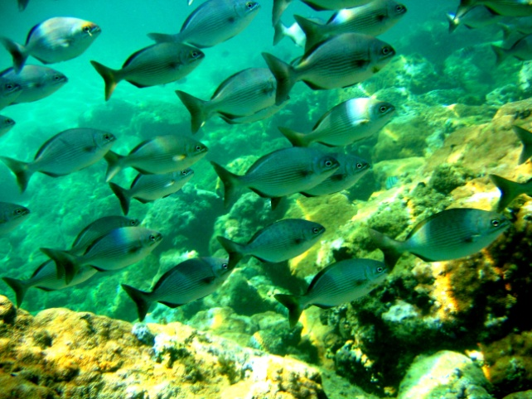

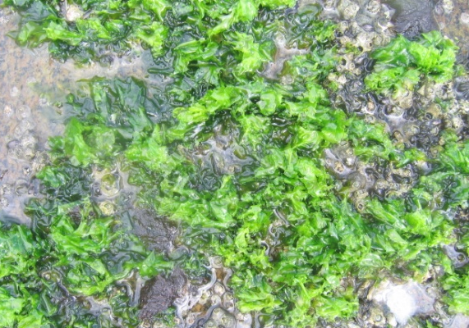


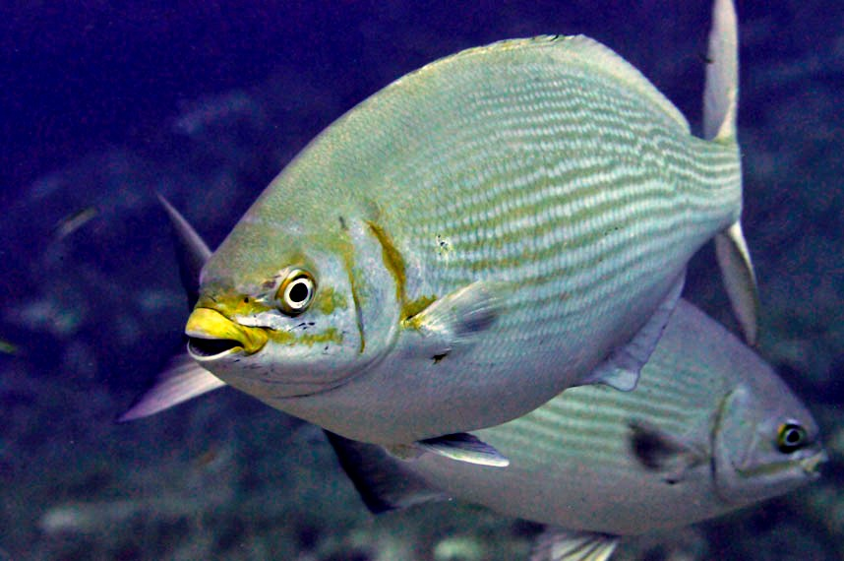
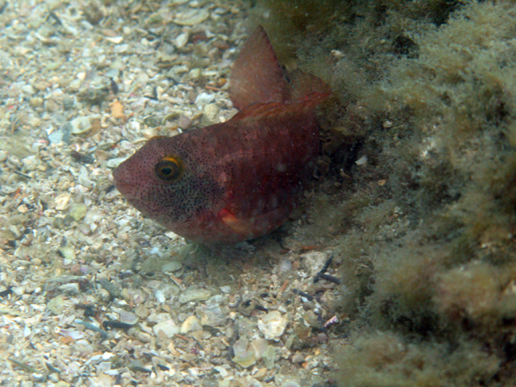
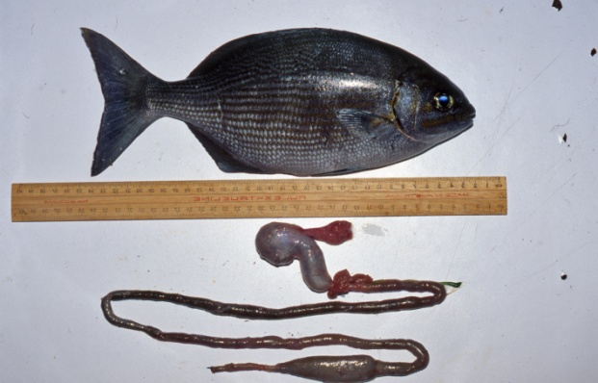
Conclusions
Green and red algae more nutritious
Montgomery & Gerking (1990); Zemke-White & Clements (1999)
Chemical defenses against herbivory:
- Codium (DMSP)
- Laurencia spp (elatol)
- Plocamium (halogenated monoterpenes)
Brown macroalgae generally avoided (complex carbohydrates that dificult digestion and polyphenols and terpens
Except for Kyphosus which selected primarily Dictyota and Dictyopteris and host a set of endosymbiontic bacteria
Pereira & Teixeira (1999); Van Alstyne & Puglisi (2007); Vasconcelos et al. (2009)
Brown macroalgae
Kyphosus
Endosymbiontic bacteria
Riemer & Wiebe (1987); Clements & Choat (1995)
Notes:
In general brown algae were largely avoided (especially Colpomenia) by most fishes. The exception was Kyphosus that selected primarily Dictyota and Dictyopteris, and to a lesser extent, Sargassum. In fact, this genera is known to posses endosymbiontic bacteria which break down algal polysaccharides helping their digestive process. Besides, most Kyphosus species are known to feed selectively over brown algae.

Slide 25

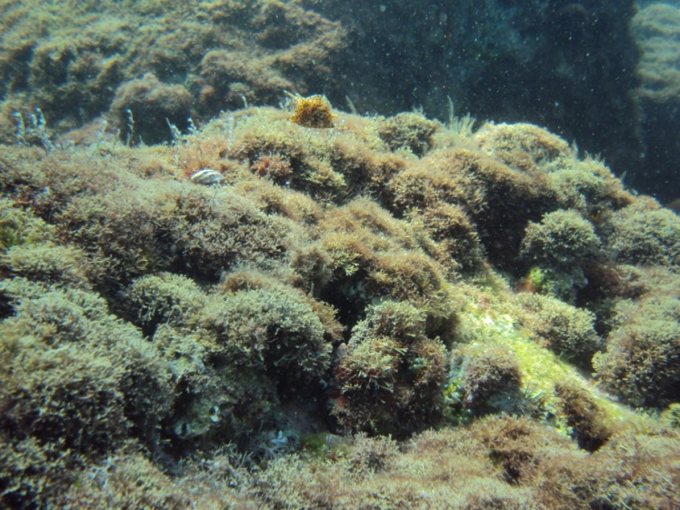
Conclusions
soft thallus and filamentous structure easily digested
Spyridia
high ash content and low nutritional value
Amphiroa
Neighbors & Horn (1991)
- Most important EAM-forming algae
- Can cover up to 90% of the area
Cordeiro et al. unpublished
Important food source for nominally herbivorous fishes on subtropical reefs
Notes:
Amphiroa

Slide 26
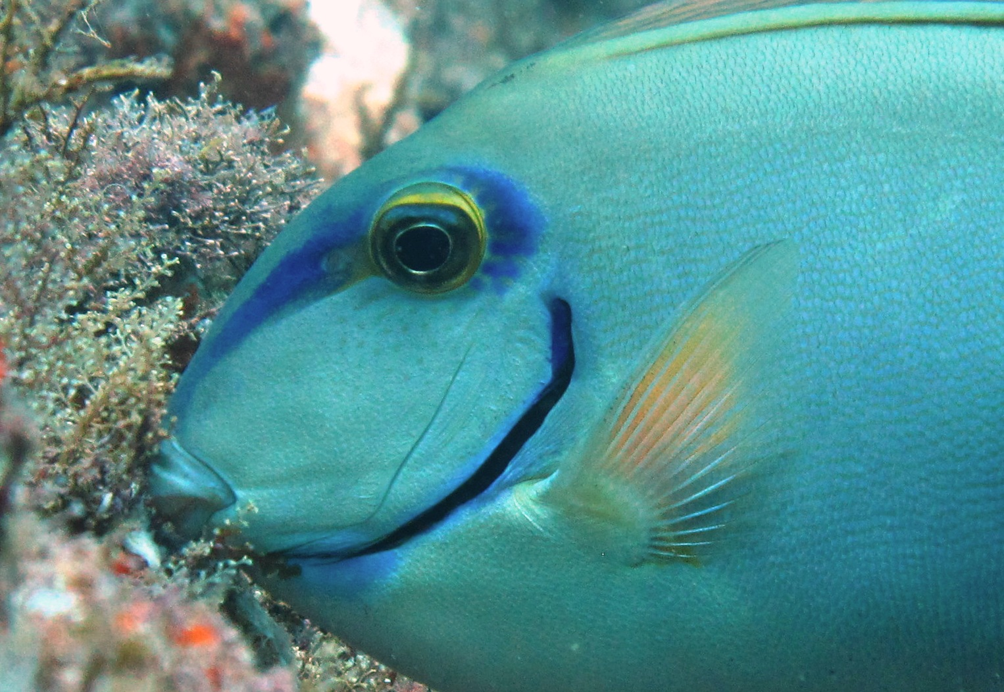



Thank you to
Cesar A. M. M. Cordeiro
Renata Mazzei C. B.
Moysés B. Cavichioli
For assistance in the field
Victor Koutsoukos
For helping with algae identification

